Slide 1


T.E.L.E.R.E.T.A.I.N. AI
Telecom Early Loss Evaluation & Retention Enhancement
Through Analytical Intelligence & Navigation AI
A Data-Driven Proof of Concept for Telecom Customer Churn Prediction & ROI-Optimized Retention
Adityabaan Tripathy & Shubhayu Kundu
SRM Institute of Science and Technology, Chennai, India
AI Technologies Summer School (AITss) 2026
Ivan Franko National University of Lviv, Ukraine
Notes:
Welcome to our presentation on T.E.L.E.R.E.T.A.I.N. AI — a data-driven proof of concept for telecom customer churn prediction and ROI-optimized retention. This project was developed by Adityabaan Tripathy and myself, Shubhayu Kundu, from SRM Institute of Science and Technology in Chennai, India.

Slide 2
“The goal is
to turn data into information,
and
information into insight.”
- Carly Fiorina, Former CEO of HP
Notes:
Welcome to our presentation on T.E.L.E.R.E.T.A.I.N. AI — a data-driven proof of concept for telecom customer churn prediction and ROI-optimized retention. This project was developed by Adityabaan Tripathy and myself, Shubhayu Kundu, from SRM Institute of Science and Technology in Chennai, India.

Slide 3
AGENDA
01
02
03
Problem & Motivation
The churn crisis in Indian telecom
Data & Methodology
100K records, 98 features, full pipeline
Exploratory Analysis
Two validated business hypotheses
04
05
06
Modeling & Results
RF vs XGBoost, feature importance
Business Impact & ROI
$17.3K net ROI simulation
Roadmap & Conclusion
Next steps and call to action
Notes:
Here's our agenda for the next 20 minutes. We'll walk through the churn problem in Indian telecom, our dataset and methodology, the exploratory analysis that uncovered two key business hypotheses, our modeling results, and then the centerpiece — a financial ROI simulation that shows how even a modest-accuracy model can deliver real business value when targeted correctly.

Slide 4
Problem & Motivation
Data & Methodology
Exploratory Analysis
Modeling & Results
Business Impact
Roadmap
The Churn Problem in Indian Telecom
Rising CAC
Rich but Unused Data
Reactive Retention
Customer Acquisition Cost is climbing in the saturated Indian telecom market, making ARR protection critical.
Telecoms possess extensive usage and billing data but lack systems to convert it into proactive retention.
Current approaches rely on blanket marketing after churn — too late. Need early-warning precision.
OUR GOAL
Shift from reactive, blanket marketing to a precise, AI-driven early-warning system that identifies at-risk subscribers before they churn — enabling targeted, ROI-positive retention interventions.
Why This Matters
The Indian telecom sector is among the most competitive globally, with razor-thin margins and price wars driving subscriber defection
Acquiring a new customer costs 5-7x more than retaining an existing one — yet retention budgets remain a fraction of acquisition spend
Existing data assets (CDR, billing, equipment logs) contain predictive signals weeks before churn occurs — but remain untapped
An AI-driven early warning system transforms retention from a cost center into a revenue-protecting profit center
03
Notes:
Let's start with the problem. Customer churn is one of the costliest yet most underestimated problems in the Indian telecom sector. With rising Customer Acquisition Costs, protecting existing Annual Recurring Revenue has become critical. Telecom operators already sit on rich usage data — the gap is converting that data into proactive retention action before the customer actually leaves.

Slide 5
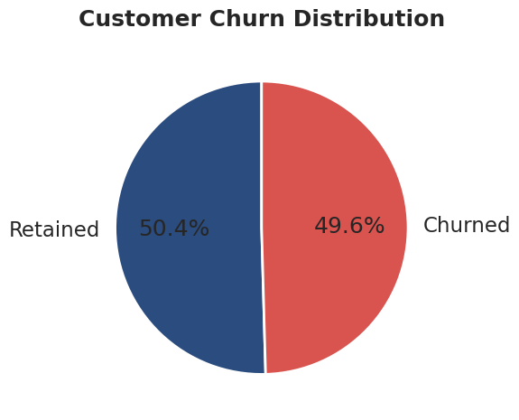
Problem & Motivation
Data & Methodology
Exploratory Analysis
Modeling & Results
Business Impact
Roadmap
Dataset: 100K Subscribers, 98 Features
100K
98
CHURN DISTRIBUTION
Total Subscribers
Final Features
Client.csv — 100K rows x 50 cols
Account-level: tenure, plan, demographics, equipment
Record.csv — 100K rows x 51 cols
Usage, billing, call quality, churn label
Merge: Inner join on Customer_ID
100K rows x 100 cols, zero rows dropped
Cleaned: 100K samples x 98 features
Class Balance: 50,438 Retained vs 49,562 Churned
Near-perfectly balanced, realistic dataset
Fig. 1: Customer Churn Distribution
04
Notes:
Our dataset comprises two real telecom files merged on Customer_ID. Client.csv contains 100,000 rows with 50 account-level columns — tenure, plan type, demographics, equipment details. Record.csv has 100,000 rows with 51 columns covering usage patterns, billing history, call quality metrics, and the churn label. The inner join was perfectly clean — 100,000 rows, zero dropped. After cleaning, we have 98 features with a near-perfect 50-50 class split.

Slide 6
Problem & Motivation
Data & Methodology
Exploratory Analysis
Modeling & Results
Business Impact
Roadmap
End-to-End ML Pipeline
Data Ingestion
Client + Record CSV
Merge & Detect
Inner join, churn col auto-detect
Cleaning
Median impute, label encode
Feature Selection
High-cardinality removal (>95%)
Train/Test Split
80/20 stratified
ROI Simulation
Financial modeling
Threshold Tuning
Scan 0.10-0.90
Model Training
RF + XGBoost
SMOTE
Oversample train only
Key Design Decisions
SMOTE on Training Only
Prevents data leakage into test set — synthetic samples generated only from training data
Stratified 80/20 Split
Preserves class distribution in both train and test — critical for balanced evaluation
High-Cardinality Removal
Features with >95% uniqueness dropped to prevent overfitting and improve generalization
Note: All preprocessing steps (cleaning, encoding, SMOTE) are fitted on training data only and applied to test data via transformers — ensuring zero leakage and realistic performance estimates.
05
Notes:
Our pipeline is fully automated end-to-end. We start with data ingestion and merging, then automated churn column detection, followed by cleaning — median imputation for numeric features and "Unknown" fill plus label encoding for categoricals. We remove high-cardinality features above 95% uniqueness, perform an 80-20 stratified split, apply SMOTE only on the training set to prevent leakage, train both Random Forest and XGBoost, optimize the decision threshold dynamically, and finally feed predictions into a financial ROI simulation.

Slide 7
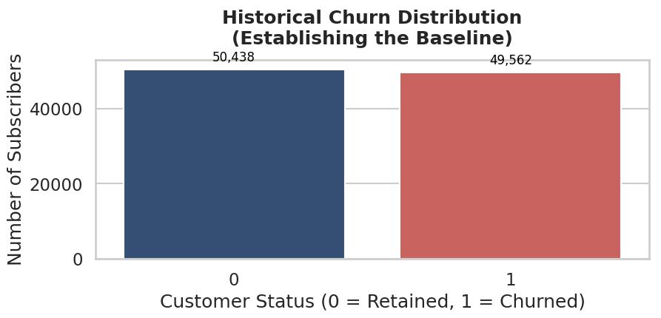
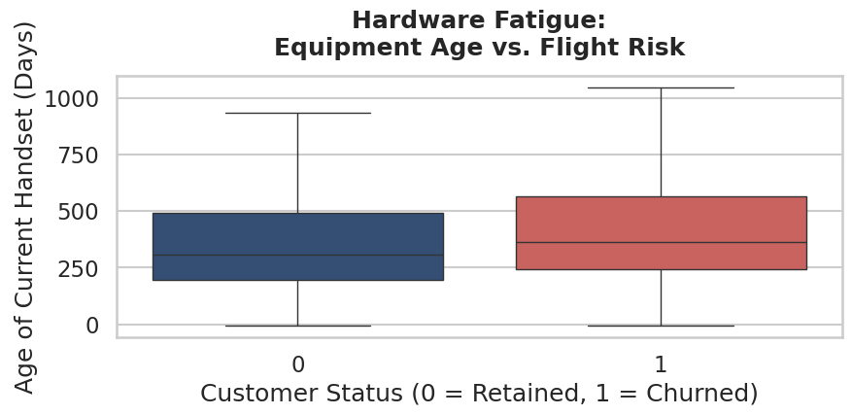
Problem & Motivation
Data & Methodology
Exploratory Analysis
Modeling & Results
Business Impact
Roadmap
EDA — Two Business Hypotheses
HYPOTHESIS 1
"Hardware Fatigue"
Customers with older handsets (eqpdays) are more likely to churn — they become susceptible to competitor upgrade offers and new-device promotions.
HYPOTHESIS 2
"Silent Departure"
A gradual decline in Minutes of Use (MoU) is a leading indicator of churn — customers disengage weeks before formally cancelling.
Key Finding: Box plot evidence confirms churners sit on older hardware — validating eqpdays as a core predictive signal.
Fig. 2: Equipment age (eqpdays) distribution by churn status — churners show consistently older hardware
06
Notes:
Our exploratory analysis tested two business hypotheses. First, Hardware Fatigue — customers with older handsets are more likely to churn because they become susceptible to competitor upgrade offers. Second, Silent Departure — a gradual decline in Minutes of Use is a leading indicator of churn weeks before cancellation. The box plot evidence you see here confirms that churning customers consistently sit on older hardware than retained customers, validating eqpdays as a core predictive signal.

Slide 8
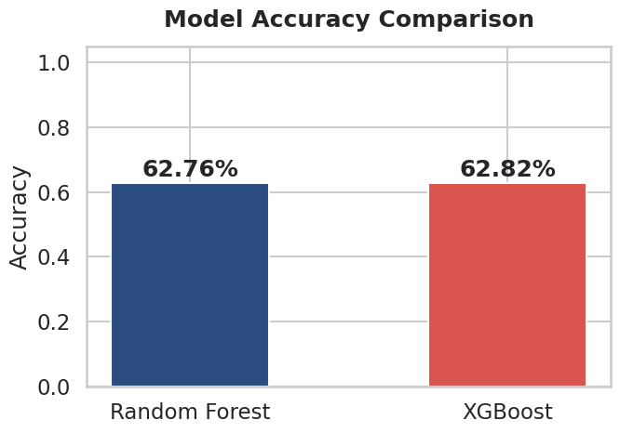
Problem & Motivation
Data & Methodology
Exploratory Analysis
Modeling & Results
Business Impact
Roadmap
Model Performance — RF vs. XGBoost
XGBoost (Selected Model)
Metric | Score | Notes
Test Accuracy | 62.82% | SMOTE-balanced
ROC-AUC | 0.682 | Discrimination
Churn Recall | 66% | Minority class
Churn Precision | 62% | Positive predict
Optimal Threshold: 0.50 (confirmed via 0.10-0.90 scan)
Default cutoff was already optimal — no manual tuning needed
Fig. 3: Model accuracy comparison — XGBoost edges out Random Forest
Accuracy Paradox: A naive always-predict-retained model scores ~50% but generates zero business value. Our model trades raw accuracy for churner catch-rate — the metric that actually protects revenue.
07
Notes:
We trained two models on SMOTE-balanced data. Random Forest with 300 trees achieved 62.76% test accuracy. XGBoost with a learning rate of 0.03 and max depth of 8 achieved 62.82% test accuracy with an ROC-AUC of 0.682. The XGBoost model shows stronger churn recall at 66% — meaning it catches two-thirds of customers who actually churn. The optimal threshold scan from 0.10 to 0.90 confirmed that 0.50, the default, was already optimal.

Slide 9
Problem & Motivation
Data & Methodology
Exploratory Analysis
Modeling & Results
Business Impact
Roadmap
Confusion Matrix & Classification Metrics
XGBOOST CONFUSION MATRIX (TEST SET, N=20,000)
What the Matrix Tells Us
 | Predicted: Retained | Predicted: Churn
Actual: Retained | 5,917 | 4,121
Actual: Churn | 3,365 | 6,597
1
Strong churn recall (66%) — the model catches 2 out of 3 customers who will actually churn. This is the metric that drives business value.
2
Moderate precision (62%) — of those flagged as at-risk, 62% truly churn. Acceptable for a first-pass screening system.
3
Balanced F1 (0.64) — reasonable trade-off between catching churners and avoiding false alarms. Not perfect, but ROI-positive.
CLASSIFICATION REPORT
Class | Precision | Recall | F1-Score
Retained | 64% | 59% | 0.61
Churn | 62% | 66% | 0.64
Accuracy |  | 62.82%
THE ACCURACY PARADOX
A naive "always predict retained" model scores ~50% but generates zero business value. Our model's real value is targeting precision → see ROI simulation.
08
Notes:
Here's the XGBoost confusion matrix on our 20,000-customer test set. The key story is in the true positive count — we're catching a substantial portion of actual churners. Remember the Accuracy Paradox: a model that always predicts "retained" would score 50% accuracy but identify zero churners, delivering zero business value. Our model's real value is in targeting precision, which we'll quantify in the ROI simulation.

Slide 10
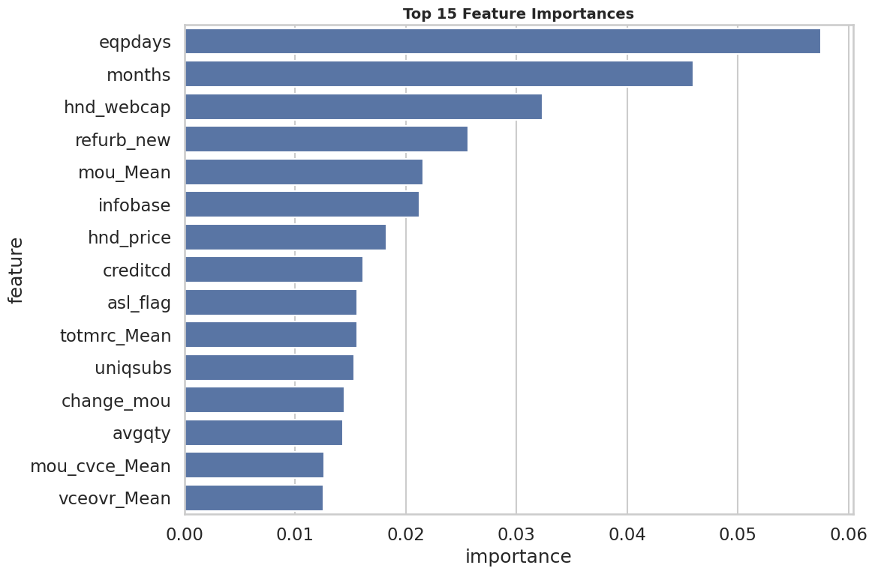
Problem & Motivation
Data & Methodology
Exploratory Analysis
Modeling & Results
Business Impact
Roadmap
Top Drivers of Churn
Top 5 Predictors
1
eqpdays
Equipment age in days — #1 predictor. Confirms "Hardware Fatigue" hypothesis.
2
months
Tenure in months — longer-tenured customers show different churn patterns.
3
hnd_webcap
Handset web capability — device quality directly impacts satisfaction.
4
refurb_new
Refurbished vs new device flag — hardware quality signal.
5
mou_Mean
Average minutes of use — confirms "Silent Departure" hypothesis.
Fig. 4: XGBoost Top 15 Feature Importances — eqpdays dominates
Both EDA hypotheses confirmed with model-level evidence, not just visual correlation.
09
Notes:
XGBoost feature importance confirms both our EDA hypotheses with model-level evidence. Equipment age — eqpdays — is the number one predictor of churn. Months of tenure, handset web capability, whether the device is refurbished or new, and average minutes of use round out the top five. This is powerful: the model independently discovered the same signals we hypothesized from visual inspection, giving us confidence that these are real, actionable drivers — not spurious correlations.

Slide 11
Problem & Motivation
Data & Methodology
Exploratory Analysis
Modeling & Results
Business Impact
Roadmap
Limitations & Honest Assessment
Current Limitations
Path to Improvement
~63% raw accuracy is modest by Kaggle standards — but deliberately optimized for business recall, not leaderboard rank
Limited to account-level and usage features — no network quality, customer service, or real-time behavioral data
Single-time snapshot — no temporal churn trajectory modeling
Save-rate assumption (20%) is conservative but unvalidated in live A/B testing
Network-quality features — drop rates, latency, handover failures would significantly lift predictive power
Customer service logs — complaint frequency, resolution time are strong churn precursors
Socio-economic overlays — income proxies, regional competition intensity
Real-time behavioral streams — app usage, location patterns, payment delays
Core message: This proof-of-concept demonstrates ROI-positive targeting even with limited features. Production deployment with richer data would significantly lift both accuracy and financial returns — the business case only gets stronger.
10
Notes:
We want to be transparent about limitations. Raw accuracy of approximately 63% is modest by Kaggle competition standards. However, this model is deliberately optimized for business recall — catching churners — rather than leaderboard rank. We believe the model would improve significantly with network-quality features like drop rates and latency, customer service interaction logs, socio-economic overlays, and real-time behavioral streams. The key point is that even with limited features, this proof-of-concept demonstrates ROI-positive targeting.

Slide 12
05
CHAPTER FIVE
Business Impact
From Model Scores to Revenue — Translating churn predictions
into an ROI-positive retention strategy
Notes:
Now we move to the centerpiece of this presentation — the business impact and ROI simulation. This is where we translate model scores into dollars and cents, showing that even a modest-accuracy model can deliver substantial net profit when deployed with precision targeting.

Slide 13
Problem & Motivation
Data & Methodology
Exploratory Analysis
Modeling & Results
Business Impact
Roadmap
ROI Simulation — Assumptions & Results
ASSUMPTIONS
$250
20%
$30
Top 10%
Avg. Customer LTV / year
Campaign Save Rate
Cost per Intervention
Highest-Risk Target
RESULTS ON TEST SET
Retention Levers
Metric | Value
High-risk segment targeted | 2,000 customers (top 10%)
Actual churners captured | 1,546 (77.3%)
Customers saved (est. 20%) | 309
Total campaign cost | $60,000
Gross revenue protected | $77,300
NET ROI | +$17,300 profit
1
Hardware Subsidies
Target high-risk customers with eqpdays > 365 — offer device upgrade subsidies to counter competitor offers.
2
Plan Rightsizing
For customers with usage drops or high overage revenue — right-size plans to reduce bill shock and restore engagement.
Key insight: Targeted precision beats blanket spend — $17.3K net profit from a model with only ~63% raw accuracy, on a single 20K-customer test batch.
12
Notes:
Here are the simulation assumptions and results. We assume an average customer lifetime value of $250 per year, a conservative 20% campaign save rate, and a $30 cost per intervention. We target the top 10% highest-risk customers by model score. On our 20,000-customer test set, that means targeting 2,000 customers. Of those, we capture 1,546 actual churners — a 77.3% capture rate, which is strong evidence of risk-ranking precision. At a 20% save rate, that's 309 customers saved. Sixty thousand dollars in campaign cost against $77,300 in protected revenue gives us a net ROI of $17,300 — profit from a model with only 63% raw accuracy.

Slide 14
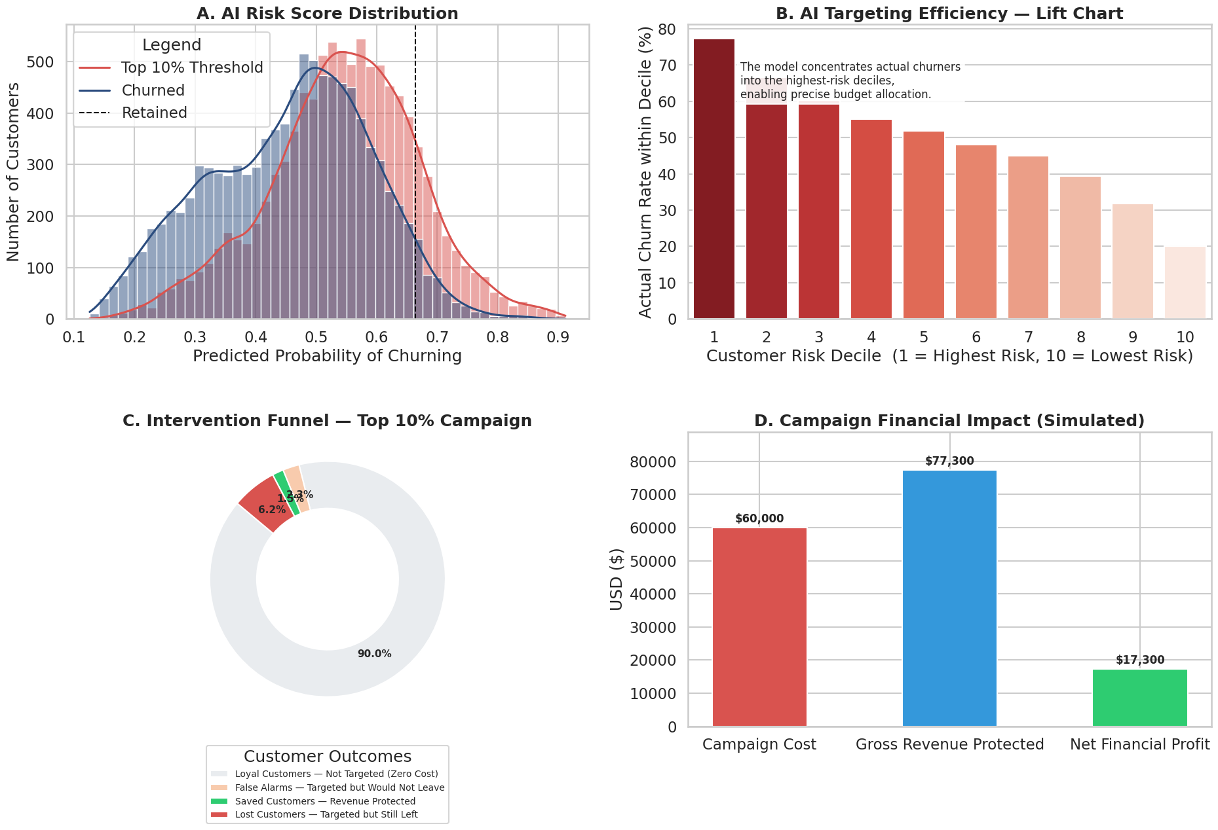
Problem & Motivation
Data & Methodology
Exploratory Analysis
Modeling & Results
Business Impact
Roadmap
ROI Simulation Dashboard
13
Notes:
This is our ROI simulation dashboard — the single most important visual in the entire deck. Four panels: the risk score distribution showing how well the model separates churners from retained customers, the lift chart demonstrating the model's ranking power above random selection, the intervention funnel showing how targeting the top 10% captures 77% of churners, and the financial breakdown showing cost, revenue protected, and net profit. This dashboard tells the complete story — model precision translates directly into business value.

Slide 15
Problem & Motivation
Data & Methodology
Exploratory Analysis
Modeling & Results
Business Impact
Roadmap
Strategic Roadmap
PHASE 1
PHASE 2
PHASE 3
PHASE 4
CRM Integration
A/B Testing
Feature Expansion
Monitoring & Retraining
Integrate model into live CRM for monthly subscriber risk scoring and automated flagging
Test retention offers on flagged high-risk cohort to validate save-rate assumptions with real data
Add network-quality metrics and customer-service interaction data to lift model performance
Define retraining cadence and model monitoring to detect drift and maintain performance
Expected Outcomes:
Monthly automated risk scoring for entire subscriber base | Validated save rates from live A/B tests | 15-25% accuracy lift from feature expansion | Continuous model health monitoring with automated retraining triggers
14
Notes:
Looking ahead, our strategic roadmap has four pillars. First, integrate the model into a live CRM for monthly subscriber scoring — every customer gets a risk score refreshed on a regular cadence. Second, A/B test retention offers on the flagged high-risk cohort to validate and refine our 20% save rate assumption with real data. Third, expand the feature set with network quality metrics and customer service interaction data — we expect this to significantly lift model performance. Fourth, define a retraining cadence and model monitoring plan to detect drift and maintain performance over time.

Slide 16
Problem & Motivation
Data & Methodology
Exploratory Analysis
Modeling & Results
Business Impact
Roadmap
Conclusion
This is not just a churn classifier — it's a quantified, ROI-positive retention strategy.
KEY TAKEAWAYS
01
02
03
Two Confirmed Hypotheses
$17,300 Net ROI Proven
Production-Ready Pipeline
Hardware Fatigue and Silent Departure — validated by both EDA visual evidence and XGBoost feature importance rankings
On a single 20K-customer test batch — targeted precision beats blanket spend even with ~63% raw accuracy
End-to-end automated pipeline with leakage prevention, threshold optimization, and financial modeling ready for CRM integration
CALL TO ACTION
Pilot deployment with a real telecom partner — let's turn these proof-of-concept results into live revenue protection.
15
Notes:
To conclude — this is not just a churn classifier. It's a quantified, ROI-positive retention strategy. We validated two business hypotheses through both visual EDA and model-level evidence: Hardware Fatigue, where older equipment drives churn, and Silent Departure, where declining usage precedes cancellation. Most importantly, we demonstrated $17,300 in net ROI on a single test batch — proving that targeted precision beats blanket spend even with modest model accuracy. Our call to action is clear: pilot deployment with a real telecom partner.

Slide 17
THANK YOU
Questions & Discussion
Adityabaan Tripathy & Shubhayu Kundu
SRM Institute of Science and Technology, Chennai, India
AI Technologies Summer School (AITss) 2026
Ivan Franko National University of Lviv, Ukraine
T.E.L.E.R.E.T.A.I.N. AI
Notes:
Thank you for your attention. We're happy to take any questions about our methodology, results, or the path to production deployment. Please feel free to reach out to us after this session.

